Slide 1
Extracting lake area from satellite imagery
Mihai-Bogdan Bîndilă - #3264424
Martin Pozdech - #2496712
Group 56

Slide 2
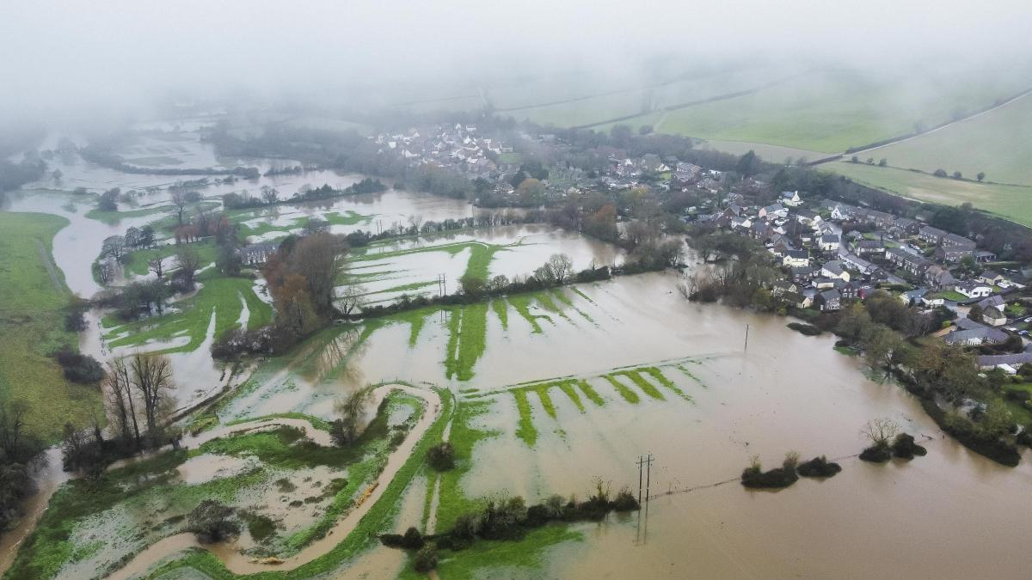
Water – a destructive force
© Yahoo UK
Notes:
Global warming causes more unpredictable and severe weather events, such as rainstorms or droughts

Slide 3
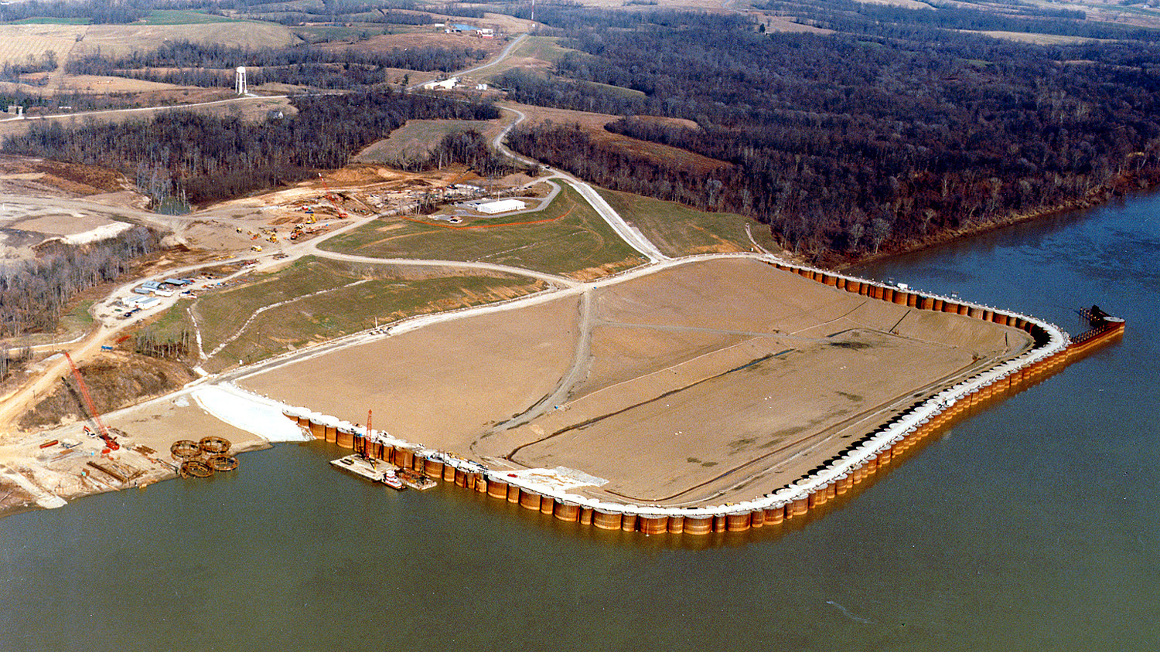
Space is at a premium
© Civil Engineer Society
Notes:
Increasing population densities creates pressure to build in more flood-prone areas

Slide 4
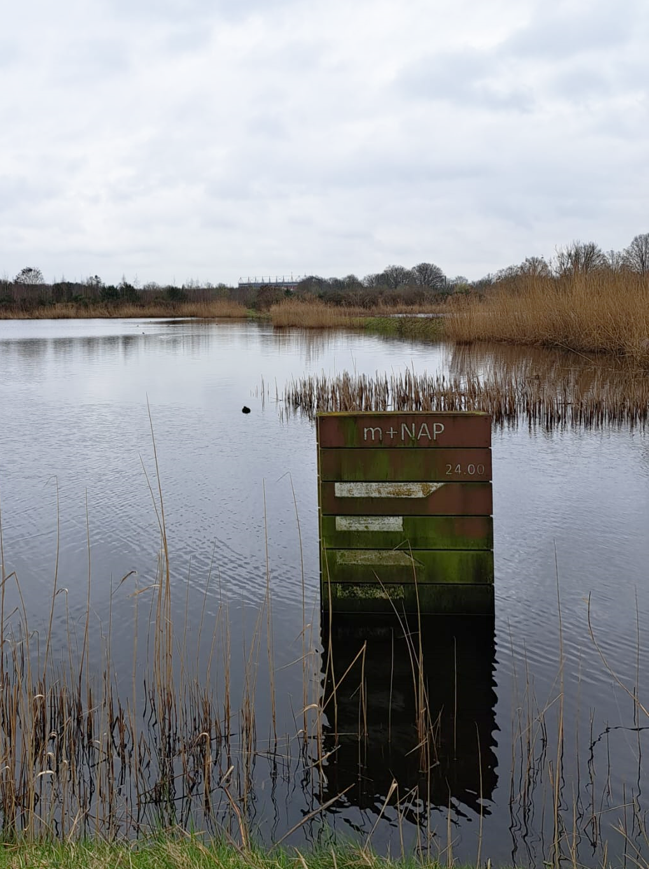
A need for water monitoring
To check if water levels are historically…
sufficient to support crop irrigation
outside of a new urban development
trending up or down
See the evolution of a waterbody
in a hassle-free manner
Notes:
They all want the same thing…
And that’s exactly what our model does

Slide 5
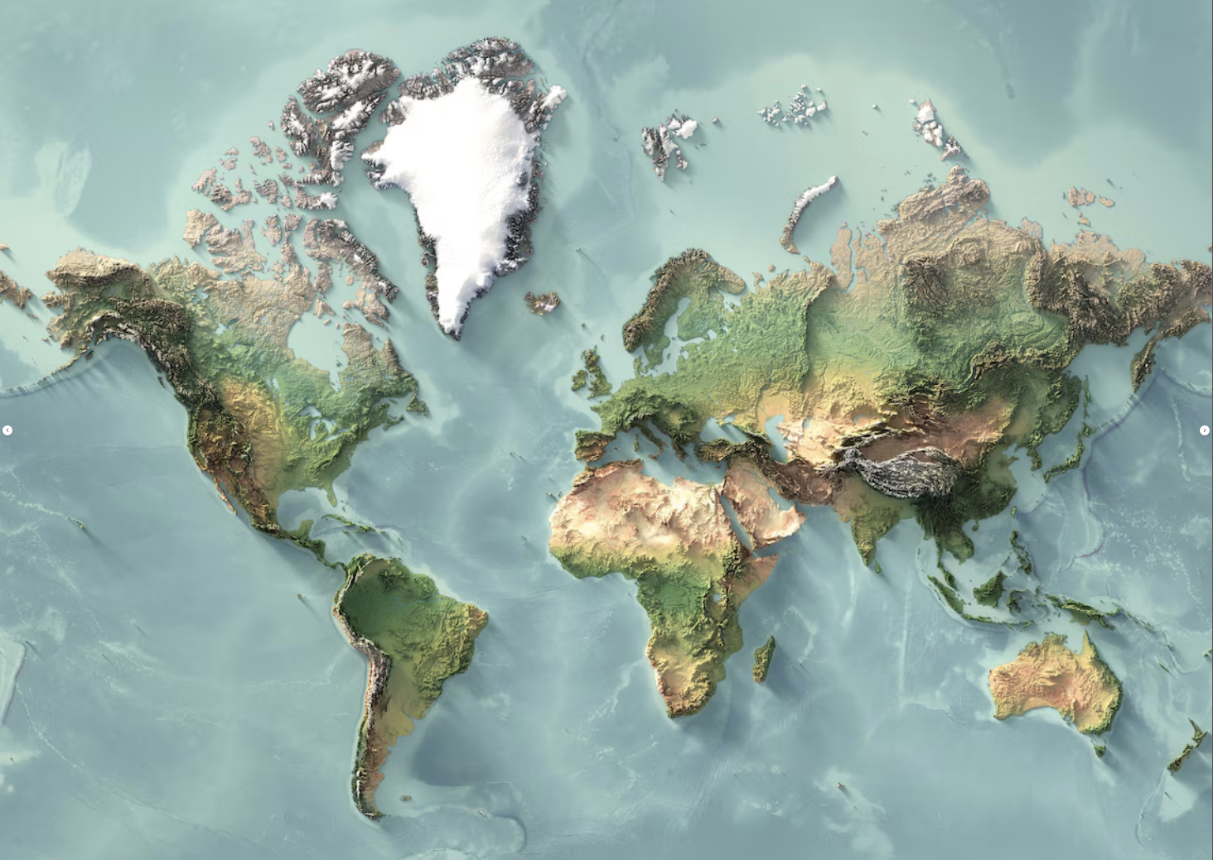
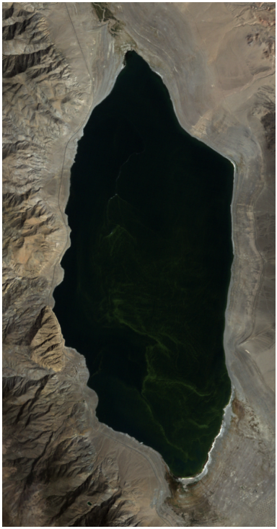
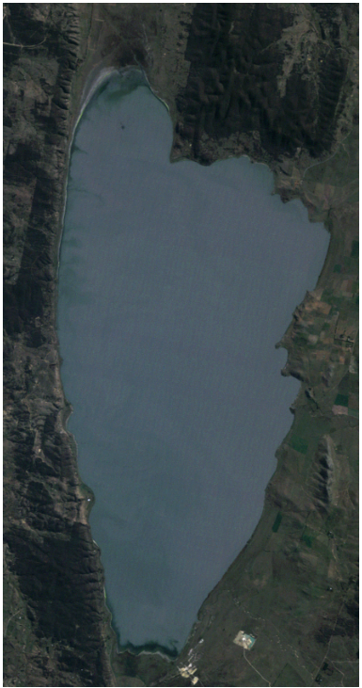

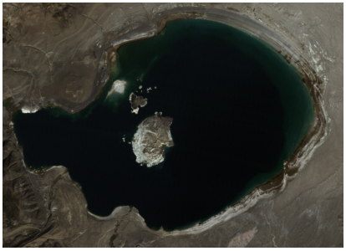
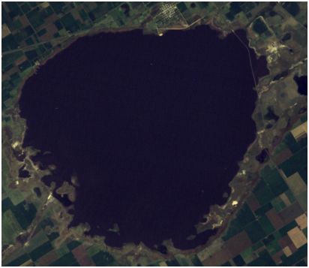
Analyzed Seasonal Lakes
Walker
George
Mono
Melincué
Notes:
We picked seasonal lakes because they have a lot of variations, and we can showcase the capabilities of our method.
Mono Lake – California, USA
George Lake – Australia, near Canberra
Walker Lake – Nevada, USA
Melincué Lake – Argentina
-> very different climates

Slide 6
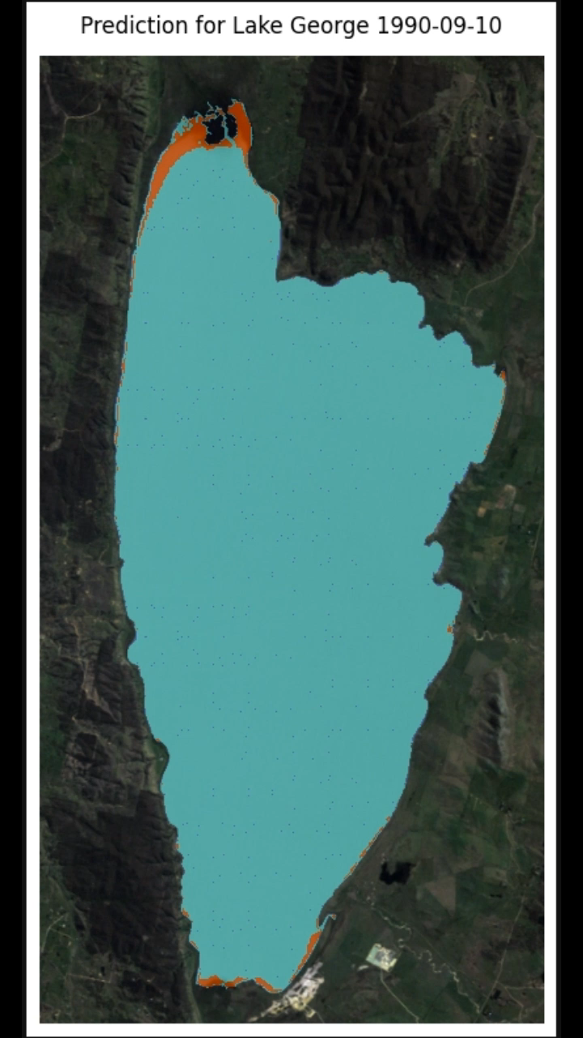
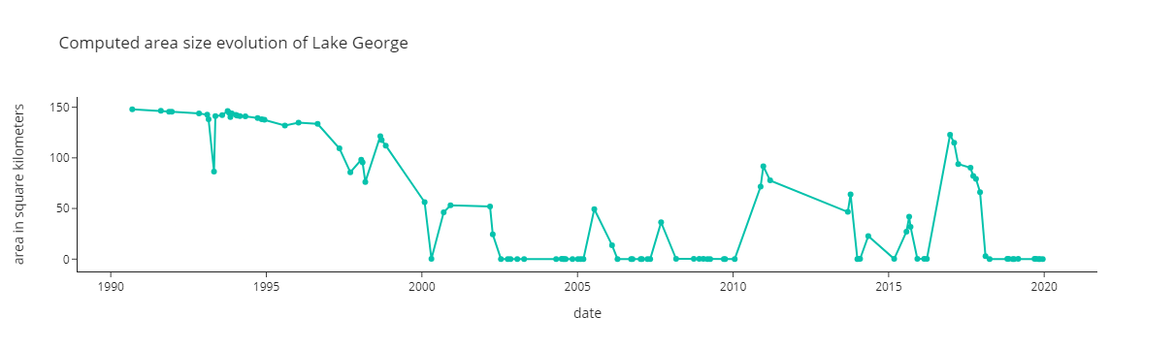
Lake George
Became empty for several periods
Enschede ~144 sq km
Correct detection
False positives
Notes:
Let’s start by looking at what our tool is able to do
Predict the lake extends for a period of more than 3 decades
Lake becomes empty for several periods
You might say: yeah, it’s a small lake so that’s why at some point is completely empty…
Actually, initially it was larger than Enschede

Slide 7
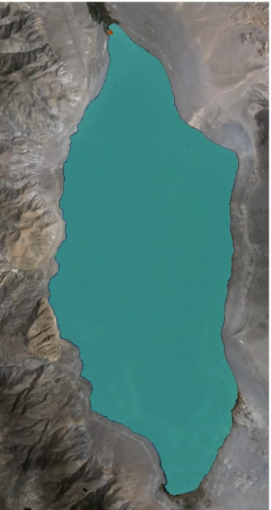
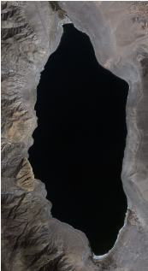
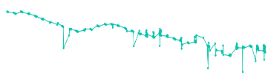
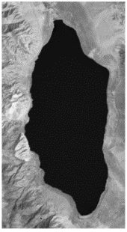
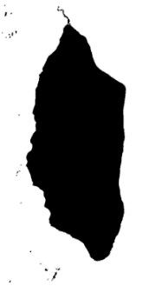


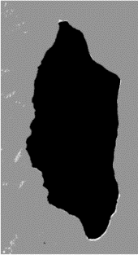

How it works?
Visualizations
Correlations
Area over time
Reproject GT and match GT and SAT images by date
Satellite images (SAT)
Filter out empty and mislabeled GT images
Find the best AWEI threshold on a group of 3 lakes
Input
coordinates
Compute the largest water extent over time
Remove false positives that do not intersect with it
Compute the water index (non-shadow AWEI)
Ground truth (GT)
From 3 satellites between 1984 and 2022
Cloud coverage < 20%
Retrieve matching evaporation and water runoff data
Notes:
Based on coordinates we gather data from Landsat 5, 7, 8 satellites for a period of 38 years and the ground truth data
AWEI = automated water extraction index (index computed based on the satellite images that contain infrared information besides color channels)

Slide 8
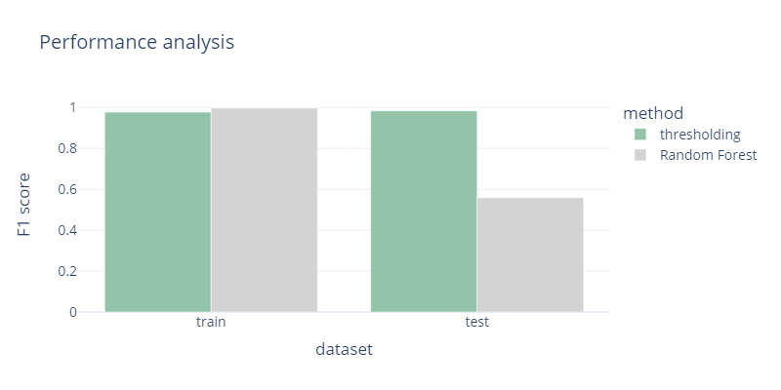
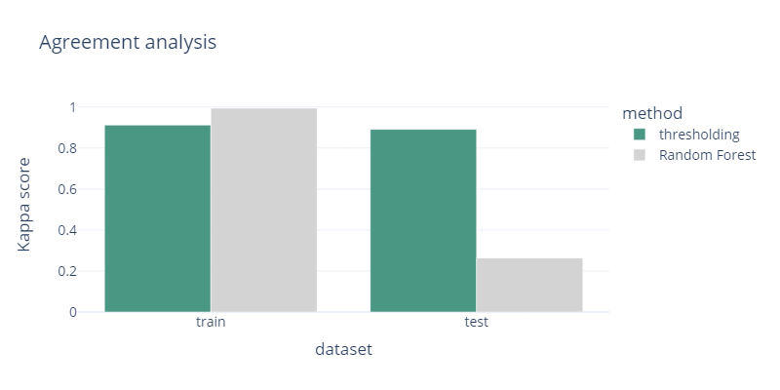
Evaluation
The averaged scores across all lakes reveal that simplicity is sometimes better
Not able to generalize
Almost perfect agreement between
predictions and ground truth
Notes:
We trained using each group of three lakes, and predicted for the fourth one
Here shown the averaged results
Optimized Random Forest model trained with the index and images is outperformed by a simple thresholding method
RF – is not able to generalize
F1 score – values between 0 and 1 (threshold – almost perfect)
Kappa – values closer to 0 => predictions correct by chance (at random)

Slide 9
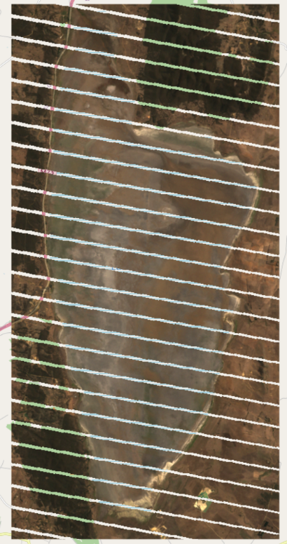
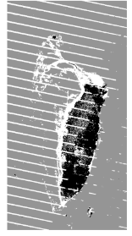
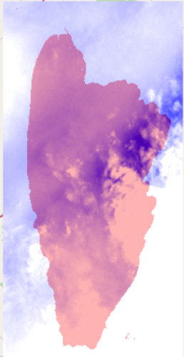
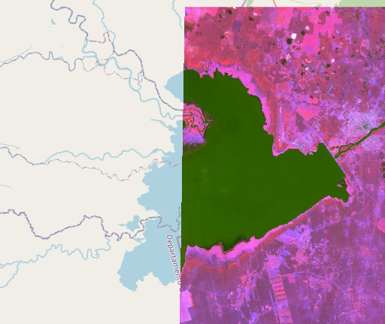
Limitations
Missing values in satellite and ground truth data
Cannot handle lakes that span across images
Clouds
Notes:
Maybe you wondered why for lake George there were many false positives. Well, the ground truth data is not that good and during our analysis we saw that the thresholding method does better than the ground truth. However, we label our predictions according to the ground truth, even though some labeled false positives are correct.
- we do not use very cloudy images -> missing potential moments of highest water level
- works only for medium-size lakes
- forecasting not possible, lacking sufficient and regular data points

Slide 10
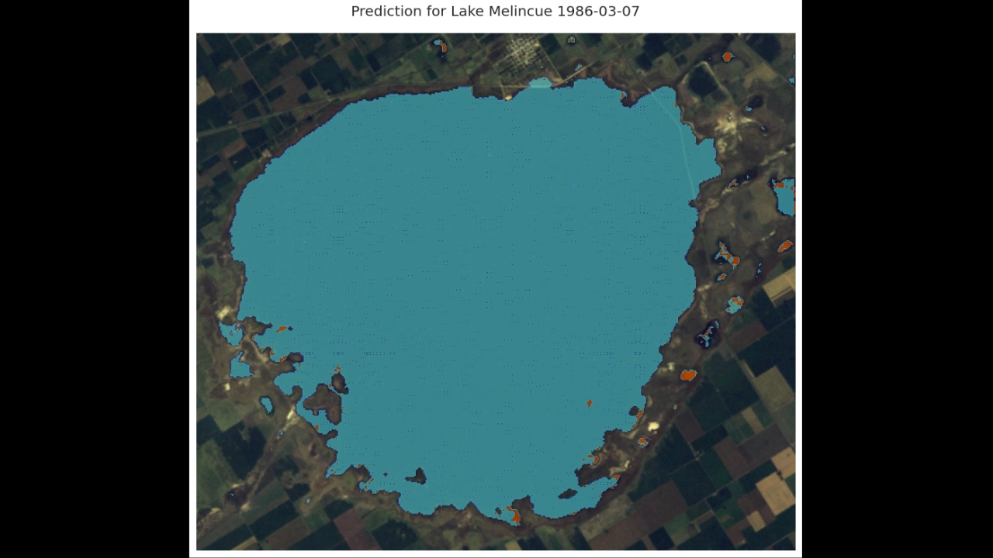
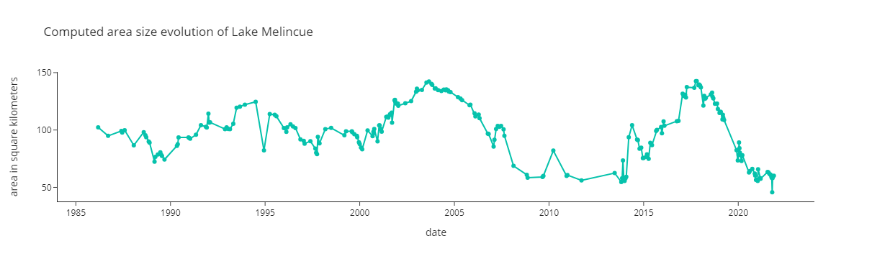
Lake Melincué
Has the most variability
Correct detection
False positives
campus size: 1.46 sq km

Slide 11
Analysis
Surface evaporation is not correlated with the lake area
The correlation between lake area and water runoff over time are
0.61
0.33
0.20
0.14
Lake George
(has forest around)
Lake Mono
(low soil permeability)
Lake Melincué
(irrigation of crops)
Lake Walker
(small watershed)
Notes:
Evaporation - values between -0.16 and 0.15
Water runoff –> water that doesn’t soak into the ground
Small watershed -> the area that drains into the lake is small, so little runoff enters the lake

Slide 12
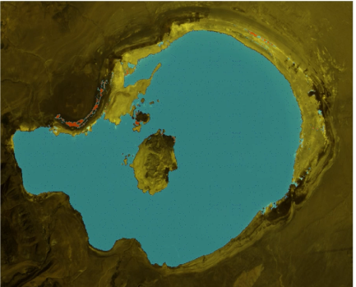
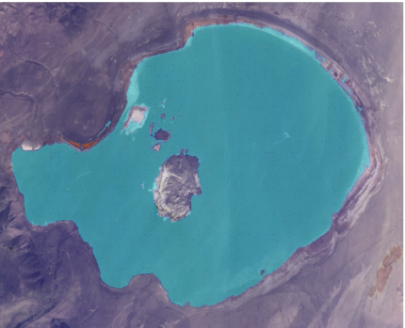
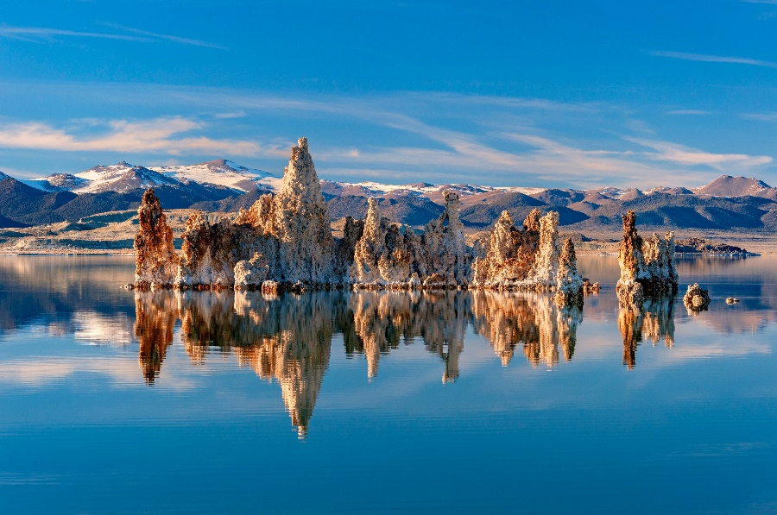
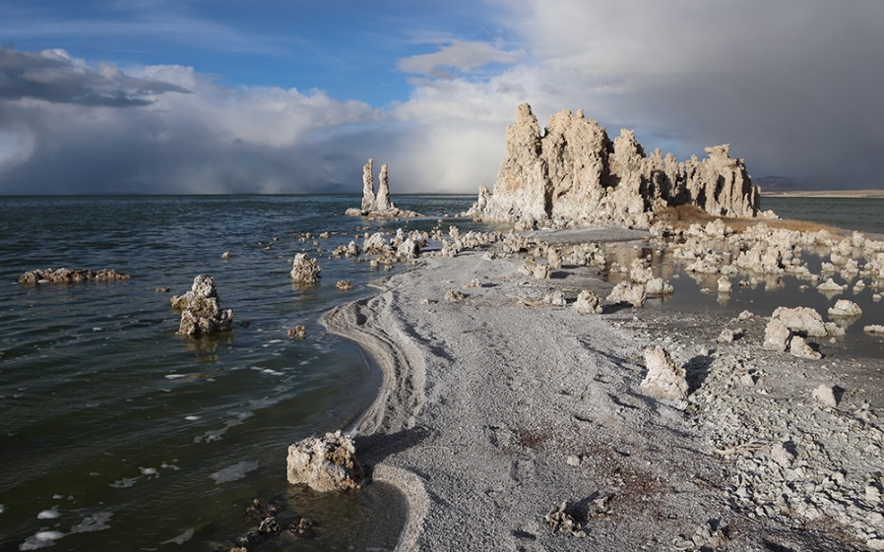
Get actionable insights
Point an area and see its history
Notes:
Let’s get back to our story. Image a real estate developer wants to build a very fancy resort for tourists in this area so that they can see this view every day.
This location seems perfect. However, our tool would reveal that 30 years ago it looked like this and there’s a very high chance to happen again.
So just by analyzing this area based on a set of coordinates you can know without hassle the historical water behavior.

Slide 13
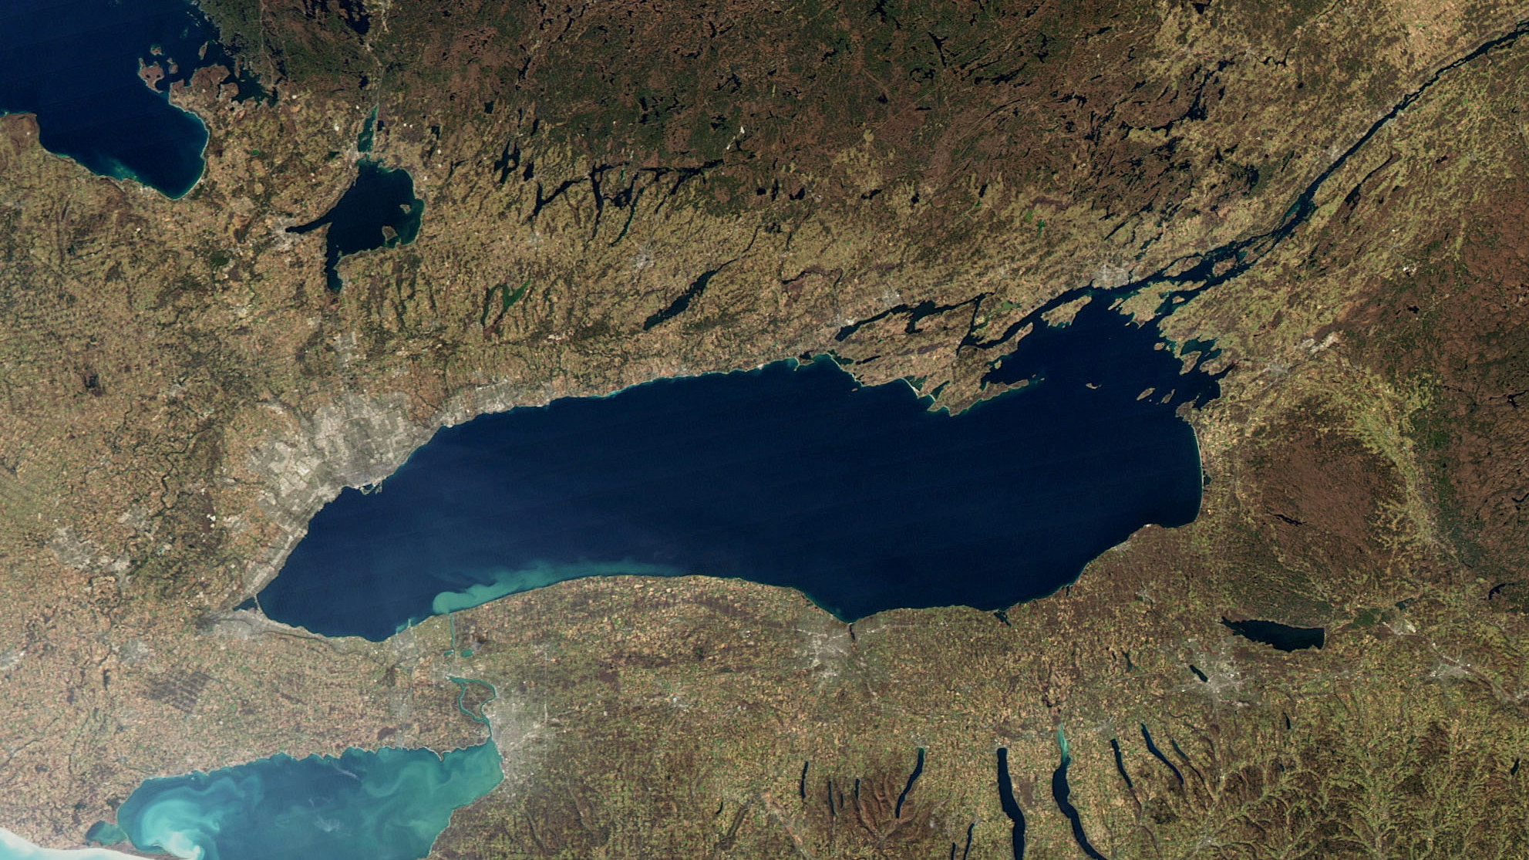
Thank you for your attention!

Slide 14
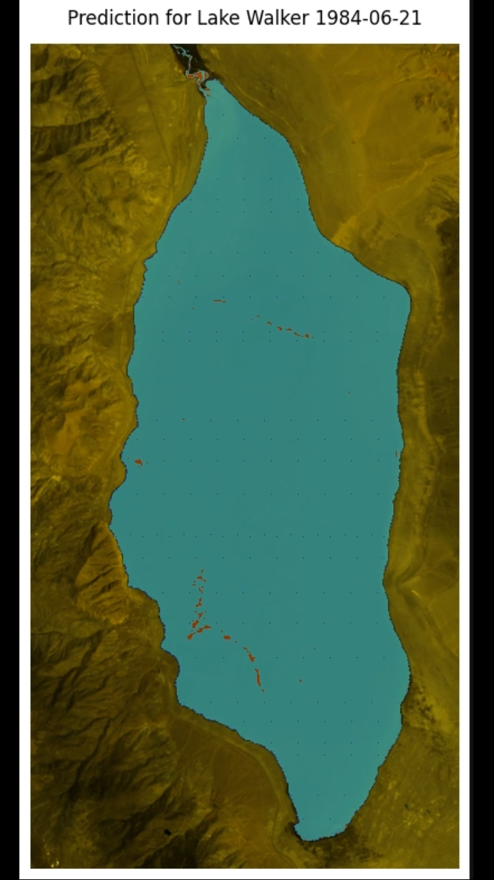
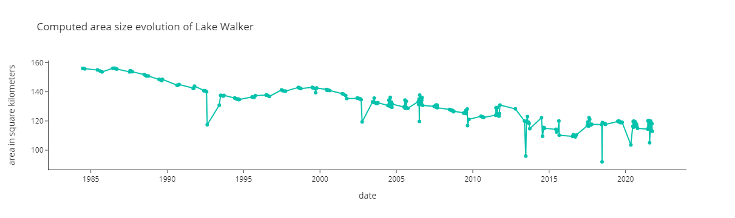
Lake Walker
Has a decreasing trend in terms of area
Correct detection
False positives

Slide 15
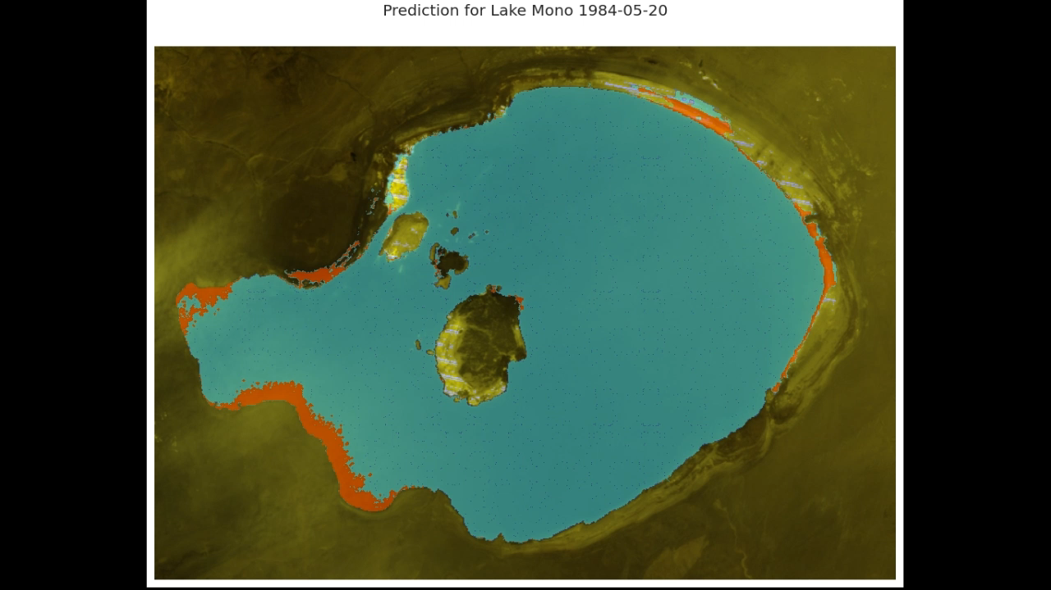
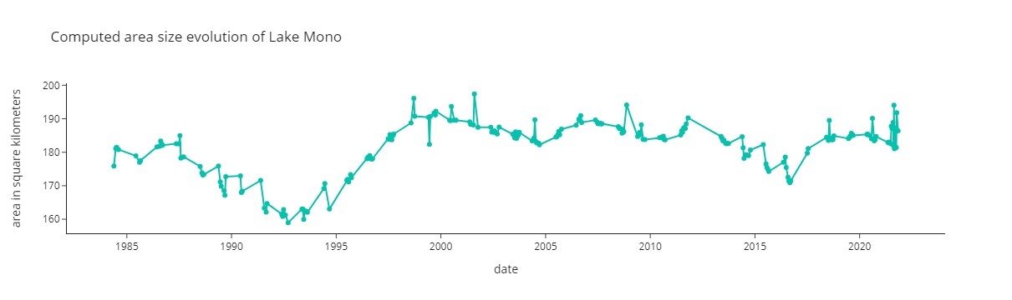
Lake Mono
It contains small bodies of land inside
Correct detection
False positives

